Slide 1
Identification of Different Medicinal Plants/Raw materials through Image Processing Using Machine Learning Algorithms
CSE7301 Capstone Project
Review-4
Batch Number:86
Under the Supervision of,
Dr.Jayanthi Kamalasekaran
School of computer science and engineering
jayanthi.k@presidencyuniversity.in
8446075868
Presidency university
Roll Number | Student Name
20211CSE0135 | D SOYA SREE
20211CSE0013 | P SRUTHI
20211CSE0478 | B PRANAVI
20211CSE0155 | B DEEKSHITHA
Name of the Program: CSE
Name of the HoD: Dr.Asif Mohammed H.B
Name of the Program Project Coordinator: Mr. Amarnath J.L & Dr. Jayanthi. K.
Name of the School Project Coordinators: Dr. Sampath A K / Dr. Abdul Khadar A / Mr. Md Ziaur Rahman

Slide 2
Introduction
a
The identification of medicinal plants and raw materials is essential for ensuring the authenticity and quality of Ayurvedic treatments.
With advancements in image processing and machine learning algorithms, automated systems.
This technology has the potential to enhance the reliability of the herbal supply chain and promote trust in medicinal plant-based products.

Slide 3
Literature Review
Patil, A. A., & Kale, K. V. (2017) Title: Plant Identification Using Leaf Recognition Based on Feature Extraction and KNN Algorithm Study Summary:
The authors implemented a system that uses shape and texture features of plant leaves.
They applied the K-Nearest Neighbor (KNN) algorithm for classification.
The system achieved over 90% accuracy in identifying 32 different plant species. Relevance: Demonstrates the effectiveness of basic ML techniques in plant classification using image features.
Zhang, S., et al. (2018) Title: Deep Learning-Based Plant Identification with Convolutional Neural Networks Study Summary:
Utilized Convolutional Neural Networks (CNNs) to identify plant species from leaf images.
A large dataset (PlantCLEF) was used, achieving significant improvements over traditional ML models.
The model was robust even with complex backgrounds and varying lighting conditions. Relevance: Validates the use of deep learning for high-accuracy plant recognition tasks.

Slide 4
Existing method Drawback
Manual Dependency: Traditional identification relies on botanists or experts, making it impractical for large-scale or remote applications.
Time-Consuming Process: Manual observation and classification are slow and inefficient, especially when handling a large number of samples.
Prone to Human Error: Misidentification can occur due to similar-looking species, fatigue, or lack of experience.

Slide 5
Proposed Method
The proposed method for identifying medicinal plants involves capturing high-quality images of raw materials and processing them using image preprocessing techniques.
Machine learning algorithms, particularly deep learning models like Convolutional Neural Networks (CNNs), will analyze these images to extract distinguishing features.
The system will then classify the plants based on trained models, ensuring reliable recognition and reducing misidentification in the supply chain.

Slide 6
Objectives
The objective of identifying medicinal plants through image processing and machine learning is to develop an automated system for accurate plant identification, reducing misidentification and adulteration.
The system aims to enhance the efficiency of raw material verification in Ayurvedic Pharmaceutics, ensuring authenticity and quality.

Slide 7
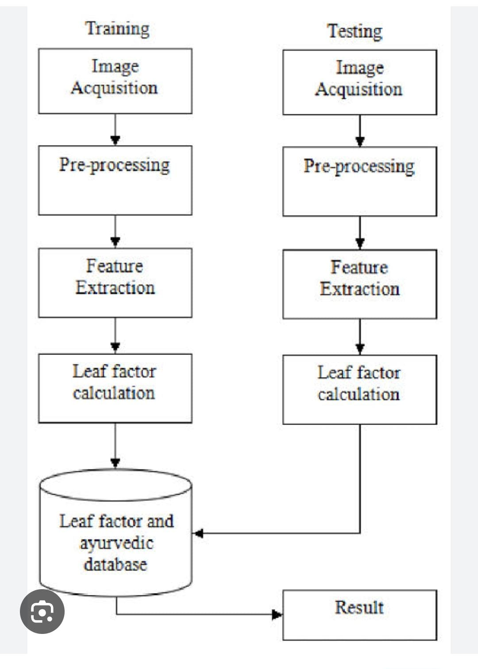
Architecture

Slide 8
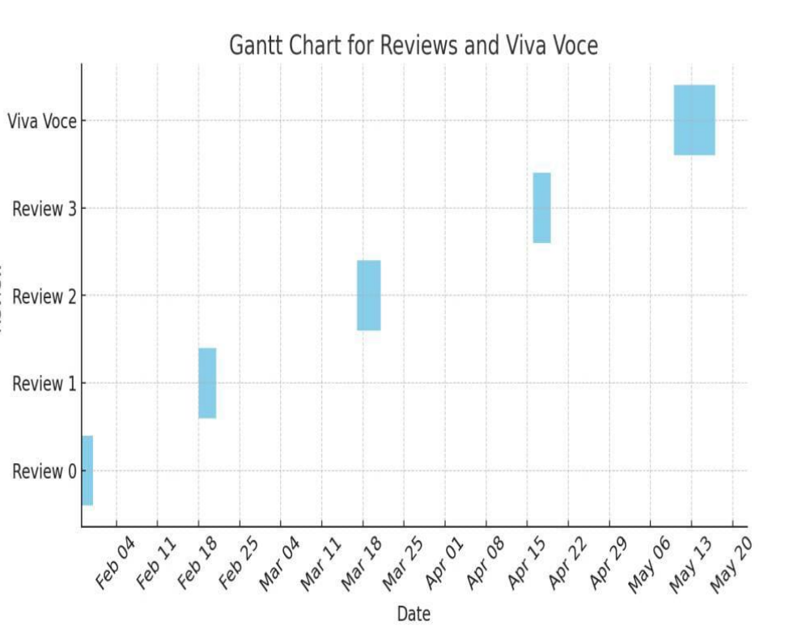
Timeline of Project

Slide 9
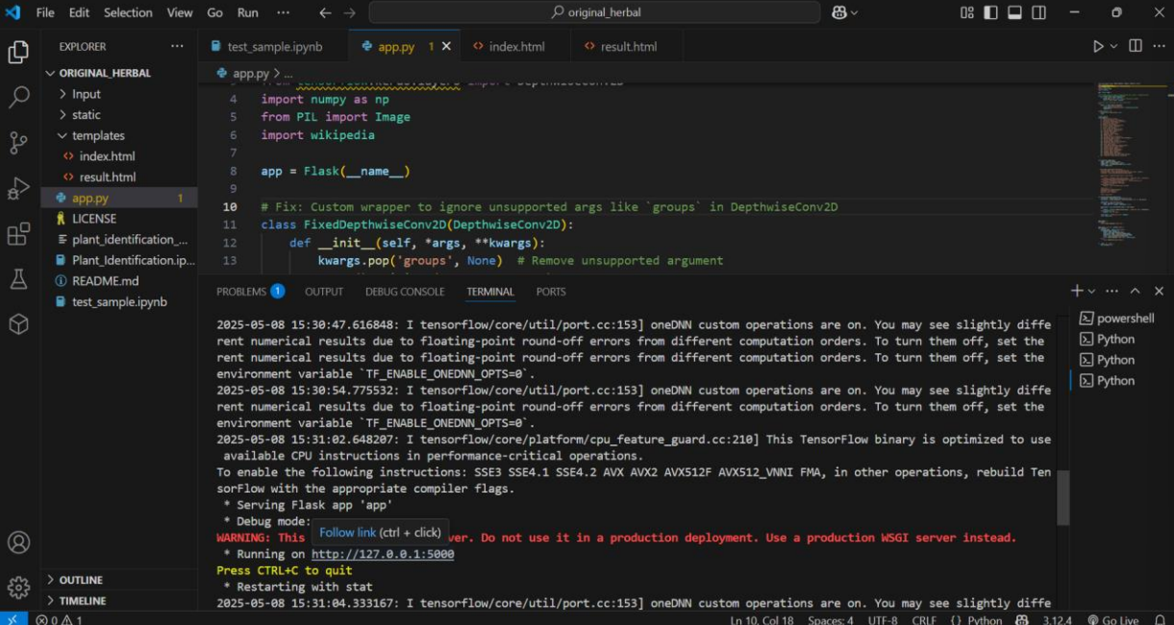
Outcomes
This image shows a Flask-based web application running locally at http://127.0.0.1:5000, displayed in Visual Studio Code.

Slide 10
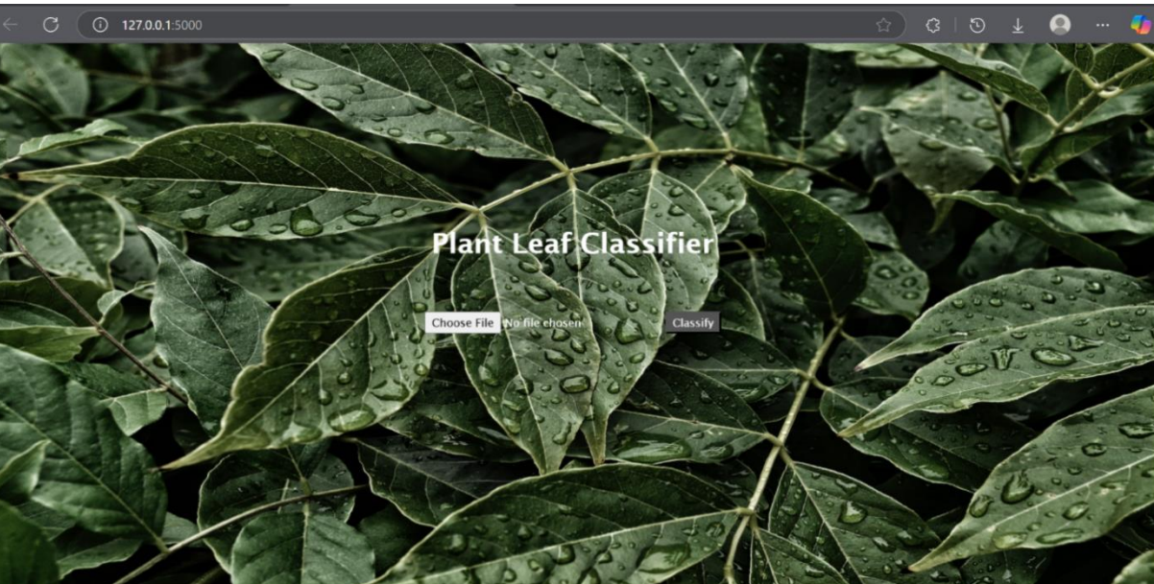
Home Page: This image shows the homepage of a web-based "Plant Leaf Classifier" application running at 127.0.0.1:5000. It features a background of green leaves with a file upload option and a "Classify" button for leaf image analysis.

Slide 11
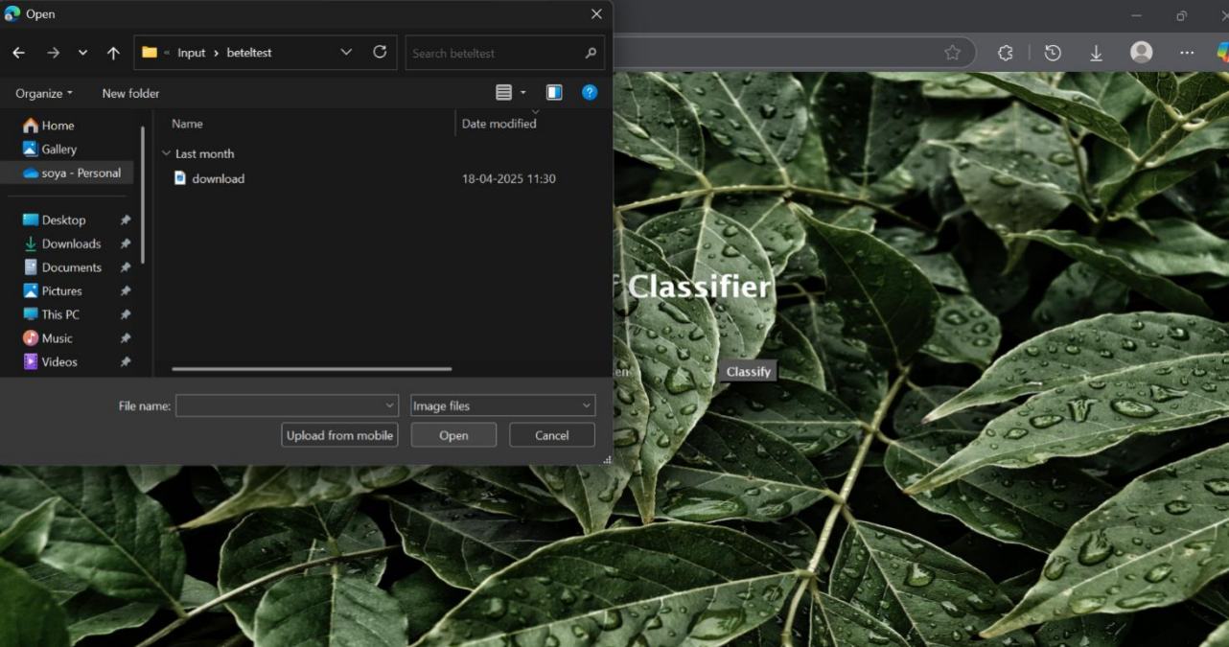
This image shows a file upload dialog open over a web application titled "Plant Leaf Classifier" running in a browser. The user is browsing the folder beteltest to select an image file for classification

Slide 12
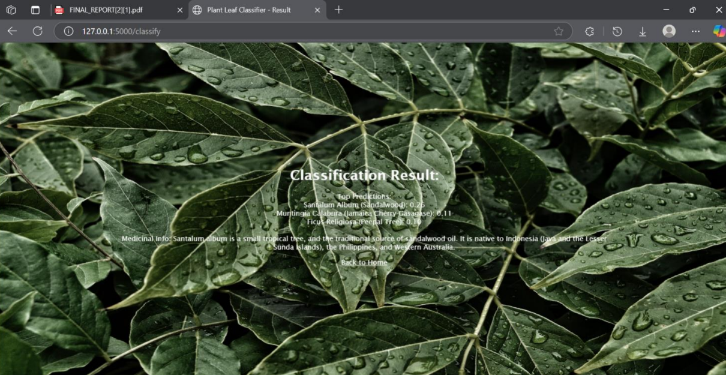
Result Page: This image shows the result page of a plant leaf classification web app hosted locally. The predicted plant is Santalum Album (Sandalwood) with associated medicinal information displayed over a background of green leaves with water droplets

Slide 13
Conclusion
The integration of image processing with machine learning algorithms offers a powerful and efficient solution to the challenges of medicinal plant identification.
By leveraging advanced techniques such as feature extraction and deep learning models, accurate identification can be achieved even in cases where plants share similar characteristic.
The development of user-friendly, accessible software for plant identification can significantly improve the supply chain and benefit stakeholders at all levels, from wholesalers to end-users

Slide 14
Github Link
The Github link provided should have public access permission.
Github Link
https://github.com/Soyadasari/Identification-of-Different-Medicinal-Plants-Raw-materials-through-Image-Processing-using-ml

Slide 15
References
https://ieeexplore.ieee.org/document/9920424
https://ieeexplore.ieee.org/document/
https://ieeexplore.ieee.org/document/10390034

Slide 16
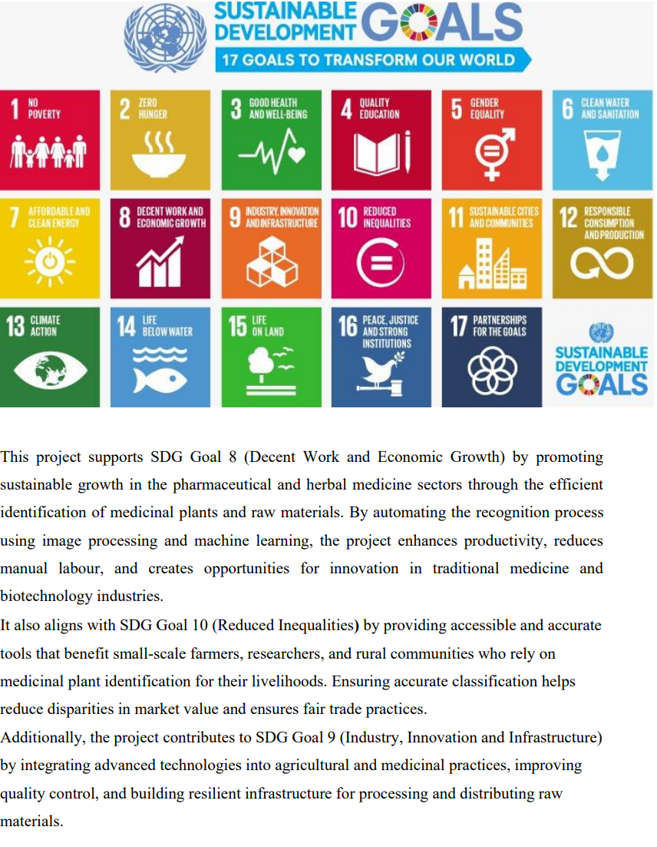
Project work mapping with SDG

Slide 17
Thank You

